Slide 1

Input-Output Organization -UNIT 4
1
Input-Output Interface
Asynchronous Data Transfer
Modes of Transfer
Priority Interrupt
Direct Memory Access
Input-Output Processor

Slide 2
Modes of Transfer
Data transfer between central computer and I/O devices may be handled in a variety of modes.
Some modes use CPU as intermediate path
and others transfer data directly to and from memory unit.
Data Transfer to or from peripheral can be handled in one of three possible modes :
Programmed I/O
Interrupt-Initiated I/O
Direct Memory Access (DMA)

Slide 3
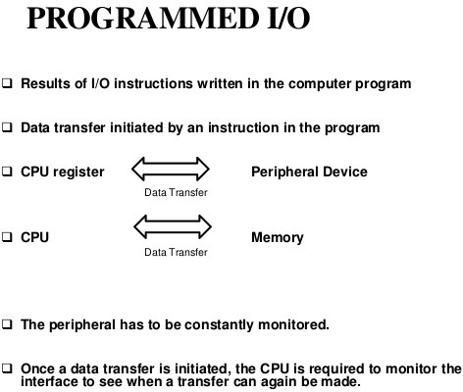

Slide 4
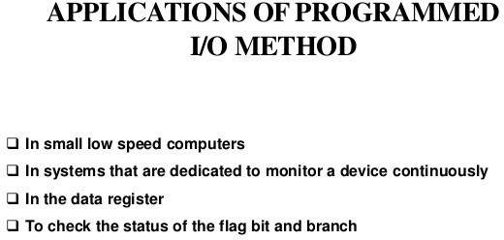

Slide 5
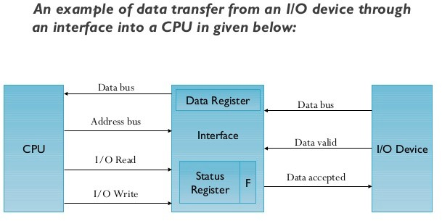

Slide 6
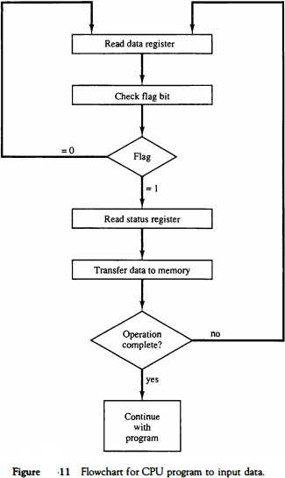

Slide 7
Programmed I/O method
In programmed I/O method, CPU stays in a program loop until the I/O unit indicated that it is ready for data transfer.
This is a time consuming process since it keeps the processor busy needlessly.
It can be avoided by using Interrupt facility and special commands to inform the interface to issue
an interrupt request signal when data are available for the device.

Slide 8
Q-In programmed I/O , CPU reads the data from data register , if flag is equal to
A= 0 B=1

Slide 9
An alternative to the CPU constantly monitoring the flag is to let the interface inform the computer when it is ready to transfer data.
This mode of transfer uses the interrupt facility. While the CPU is running a program, it does not check the flag.
However, when the flag is set, the computer is momentarily interrupted from proceeding with the current program and is informed of the fact that the flag has been set.
The CPU deviates from what it is doing to take care of the input or output transfer.
After the transfer is completed, the computer returns to the previous program to continue what it was doing before the interrupt.
The CPU responds to the interrupt signal by storing the return address from the program counter into a memory stack and then control branches to a service routine that processes the required I/O transfer.

Slide 10
In principle, there are two methods for accomplishing the way that the processor chooses the branch address of the service routine varies from one unit to another..
One is called vectored interrupt and the other, nonvectored interrupt. In a non vectored interrupt, the branch address is assigned to a fixed location in memory.
In a vectored interrupt, the source that interrupts supplies the branch information to the computer. This information is called the interrupt vector.

Slide 11
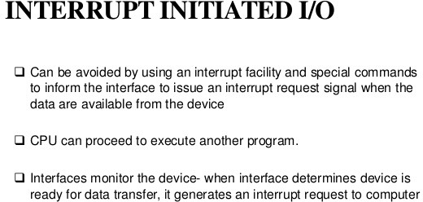

Slide 12
Priority Interrupts
Priority
Determines which interrupt is to be served first when two or more requests are made simultaneously
Also determines which interrupts are permitted to interrupt the computer while another is being serviced
Higher priority interrupts can make requests while servicing a lower priority interrupt
A priority interrupt is a system that establishes priority over the various sources to determine
- which condition is to serviced first when two or more requests arrive simultaneously
-which conditions are permitted to interrupt the computer while another request is being serviced

Slide 13
Priority Interrupts
Priority Interrupt by Software (Polling)
Polling procedure is used to identify highest priority source by software means
common branch address for all the interrupts
Priority is established by the order of polling the devices(interrupt sources)
- highest priority device is tested first and if interrupt is on , control branches to service routine for this source otherwise next lower priority source is tested
Flexible since it is established by software
Low cost since it needs a very little hardware
Very slow
if there are many interrupt time required to poll may exceed time available to service IO device

Slide 14
Priority Interrupts
Priority Interrupt by Hardware
Require a priority interrupt manager which accepts all the interrupt requests to determine the highest priority request.
Fast since identification of the highest priority interrupt request is identified by the hardware
Fast since each interrupt source has its own interrupt vector to access directly to its own service routine
- Can be addressed using serial or parallel connection of interrupt lines.
Example of serial is Daisy chaining Priority

Slide 15
Hardware Priority Interrupts – Daisy Chain
 | VAD 1 |  |  | VAD 2 |  |  | VAD 3
Device 1 PI PO |  |  | Device 2 PI PO |  |  | Device 3 PI PO |  | To de
 | Interrupt |  |  | request
Serial hardware priority function
Interrupt Request Line
Single common line
Interrupt Acknowledge Line
Daisy-Chain
next vice
INT
CPU
INTACK
Interrupt acknowledge
-Serial connection of all device that request an interrupt
-Device with highest priority placed in first position followed by devices with lower priority and so on.
-Interrupt generated by any device signals low state interrupt line
-CPU responds by enabling interrupt acknowledgement (INTACK) line.
- device receives PI=1 and passes to next only when not requesting else PI=0
-Thus device with PI=1 and PO=0 is one with highest priority requesting interrupt

Slide 16
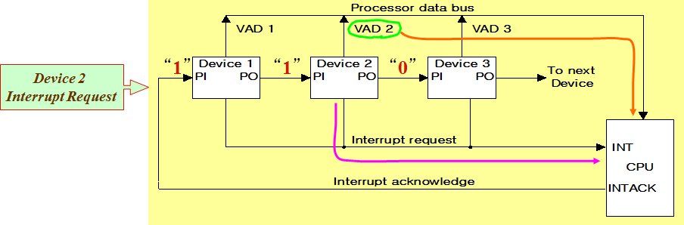
Hardware Priority Interrupts – Daisy Chain
Example: Daisy chain working

Slide 17
Parallel Priority Interrupts
IEN:
Set or Clear by instructions ION or IOF
IST: Represents an unmasked interrupt has occurred.
INTACK enables tristate Bus Buffer to load VAD generated by the Priority Logic
Interrupt Register:
Each bit is associated with an Interrupt Request from different Interrupt Source - different priority level
Each bit can be cleared by a program instruction
Mask Register:
Mask Register is associated with Interrupt Register
Each bit can be set or cleared by an Instruction

Slide 18
Parallel Priority Interrupts
Interrupt register
Bus Buffer
Disk
0
I ₀
y
x
0
0
0
0
0
0
Printer
1
I ₁
Priority
_{I 2} encoder
Reader
2
VAD
to CPU
Keyboard
3
I ₃
0
IEN
IST
Mask register
1
Enable
2
Interrupt to CPU
3
INTACK
from CPU

Slide 19
Priority Encoder
Determines the highest priority interrupt when more than one interrupts take place
Priority Encoder Truth table
Inputs
Outputs
I₀ | I₁ | I₂ | I₃ |  | x | y | IST | Boolean functions
1 | d | d | d |  | 0 | 0 | 1
0 | 1 | d | d |  | 0 | 1 | 1
0 | 0 | 1 | d |  | 1 | 0 | 1 | x = I₀' I₁'
0 | 0 | 0 | 1 |  | 1 | 1 | 1 | y = I₀' I₁ + I₀’ I₂’
0 | 0 | 0 | 0 |  | d | d | 0 | (IST) = I₀ + I₁ + I₂ + I₃

Slide 20
Interrupt Cycle
At the end of each Instruction cycle
CPU checks IEN and IST
If IEN · IST = 1, CPU -> Interrupt Cycle
SP ← SP - 1 M[SP] ← PC INTACK ← 1. PC ← VAD IEN ← 0
Decrement stack pointer Push PC into stack
Enable interrupt acknowledge Transfer vector address to PC Disable further interrupts
Go To Fetch to execute the first instruction in the interrupt service routine

Slide 21
Initial and Final Operations
0
1
2
3
7
Program to service
magnetic disk
JMP DISK
DISK
3
JMP PTR
VAD=00000011
JMP RDR
PTR
Program to service
line printer
JMP KBD
8
KBD
1
Main program
RDR
Program to service character reader
interrupt
749
750
current instr.
KBD
4
Program to service
keyboard
11
Stack
2
5
255
256
256
Disk
750
interrupt
6
9
10

Slide 22
Initial and Final Operations
Each interrupt service routine must have an initial and final set of operations for controlling the registers in the hardware interrupt system
Initial Sequence
Clear lower level Mask reg. bits
IST <- 0
Save contents of CPU registers
IEN <- 1
Go to Interrupt Service Routine
Final Sequence
IEN <- 0
Restore CPU registers
Clear the bit in the Interrupt Reg
Set lower level Mask reg. bits
Restore return address, IEN <- 1

Slide 23
Direct Memory Access
Block of data transfer between high speed devices like Disk and Memory
DMA controller - Interface which takes over the buses to manage the transfer directly between
Memory and I/O Device, freeing CPU for other tasks
CPU initializes DMA Controller by sending memory address and the block size (number of words)
Address register:
Contains an address to specify Desired location in memory
Word count register
Holds no. of words to be transferred
Control register
Specifies the mode of transfer

Slide 24
Direct Memory Access
24
Fig 1: CPU bus signals for DMA transfer
ABUS DBUS
RD WR
Address bus
Bus request
BR
Data bus Read Write
CPU
Fig 2: Block diagram of DMA controller
Bus granted
BG
Data bus
Data bus
Address bus
buffers
buffers
DMA select
DS
RS RD
WR BR
Internal Bus
Address register
Read Write
Bus request
Word count register
Control logic
Control register
Bus grant Interrupt
BG Interrupt
DMA request
DMA acknowledge
to I/O device

Slide 25
Direct Memory Access
25
RD and WR is bidirectional
When BG=0 CPU can communicate with DMA Register
When BG=1 CPU left the buses and DMA can communicate directly with memory
DMA Transfer can be made in several ways
Burst Transfer : a block sequence consisting of memory words is transferred
in continuous burst while the DMA controller is master of memory bus
- This mode of transfer is needed for fast devices such as magnetic disk where data transmission cannot be stopped or slowed down until an entire block is transferred
Cycle stealing : Alternative technique called cycle stealing allows DMA controller to transfer one data word at time after which it must return control of the buses to the CPU.
- CPU merely delays its operation for one memory cycle to allow the direct memory I/O transfer to “steal” one memory cycle

Slide 26
DMA I/O Operation
26
DMA is first initialized by CPU. After that DMA starts and continues to transfer data between memory and peripheral unit until an entire block is transferred.
CPU initializes the DMA by sending following information through data bus:
Starting address of the memory block (for read/write)
Word Count (no. of words in memory block)
Control to specify mode of transfer (E.g. read/write)
A control to start DMA Transfer

Slide 27
DMA Transfer
27
Interrupt
BG
Random-access memory unit (RAM)
CPU
BR
RD
WR
Addr
Data
RD
WR
Addr
Data
Read control
Write control Data bus Address bus
Address select
RD DS
WR
Addr
Data
I/O Peripheral
device
DMA ack.
RS
DMA
Controller
BR
BG
DMA request
Interrupt

Slide 28
I/O Processor - Channel
28
Channel
Processor with direct memory access capability that communicates with I/O devices
Channel accesses memory by cycle stealing
Unlike DMA Controller, IOP can fetch and execute its own instruction
IOP Instructions (Commands) specially designed to facilitate I/O transfer.
Data gathered in IOP at device rate and bit capacity while CPU executing own program
Transfer between IOP and Device similar to Programmed I/O and transfer between IOP and Memory similar to DMA
CPU is master while IOP is slave processor
- CPU initiates the channel by executing a channel I/O class instruction and once initiated, channel operates independent of the CPU
Central processing unit (CPU)
Memory unit
Memory Bus
Peripheral devices
PD PD
PD
PD
Input-output processor (IOP)
I/O bus

Slide 29
Channel CPU Communication
29
CPU operations
IOP operations
Send instruction to test IOP.path
Transfer status word
to memory
If status OK, then send start I/O instruction
to IOP.
Access memory for IOP program
CPU continues with another program
Conduct I/O transfers using DMA;
Prepare status report.
I/O transfer completed; Interrupt CPU
Request IOP status
Transfer status word to memory location
Check status word for correct transfer.
Continue

